Slide 1
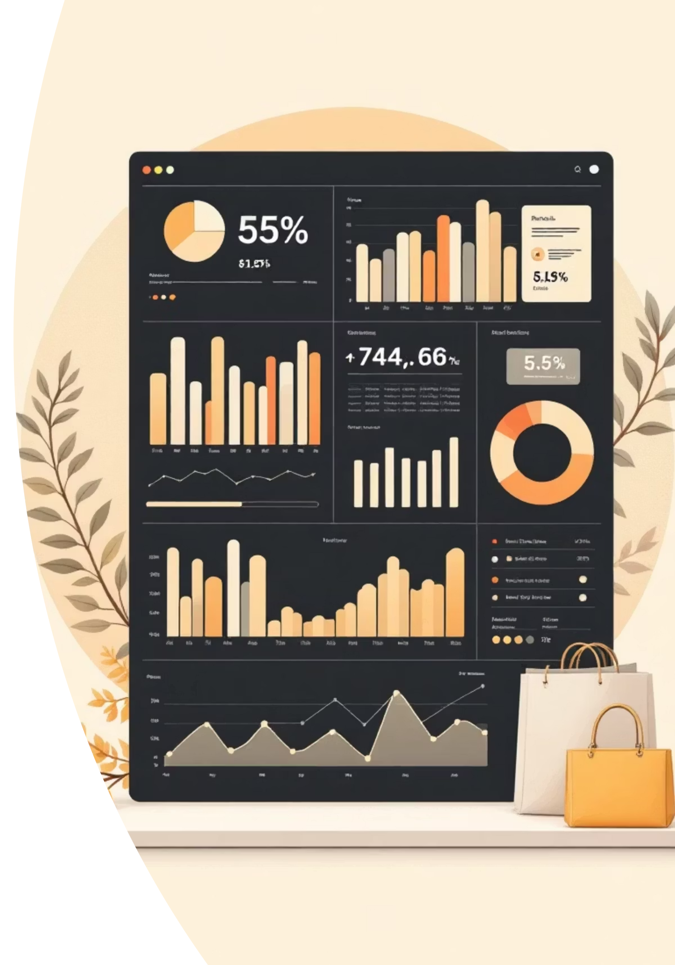
Customer Shopping Behavior Analysis
Uncovering actionable insights from 3,900 customer purchases to drive strategic business decisions and optimize revenue growth

Slide 2

Dataset Overview
3,900
18
37
Total Purchases
Data Columns
Missing Values
Comprehensive transaction records analyzed
Customer demographics, behavior & transaction details
Only in Review Rating column (handled via median imputation)

Slide 3
Data Preparation Process
Our rigorous approach to data cleaning and transformation ensured analysis accuracy and reliability.
01
02
03
Data Loading
Initial Exploration
Missing Data Handling
Imported dataset using pandas for efficient data manipulation
Conducted structure checks and generated summary statistics
Imputed Review Rating missing values with median values to preserve data integrity
04
05
Feature Engineering
Database Integration
Created age groups and calculated purchase frequency metrics for deeper insights
Connected to MySQL for scalable analysis and reporting capabilities

Slide 4

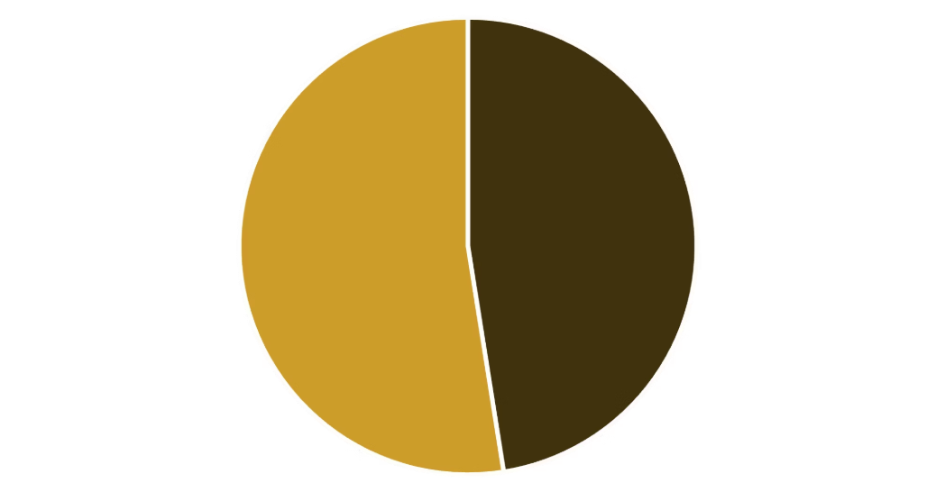
Revenue by Gender Analysis
Key Insight
Female customers generate slightly higher total revenue compared to male customers, presenting an opportunity for targeted campaigns.
Gender-based marketing strategies and product recommendations could significantly optimize revenue streams and improve customer engagement.

Slide 5

High-Value Discount Users
A unique segment of customers who spend above average while actively using discounts represents a strategic opportunity.
Smart Shoppers
High spenders who maximize value through strategic discount utilization
Strategic Opportunity
Target these premium customers with exclusive VIP offers and loyalty rewards

Slide 6
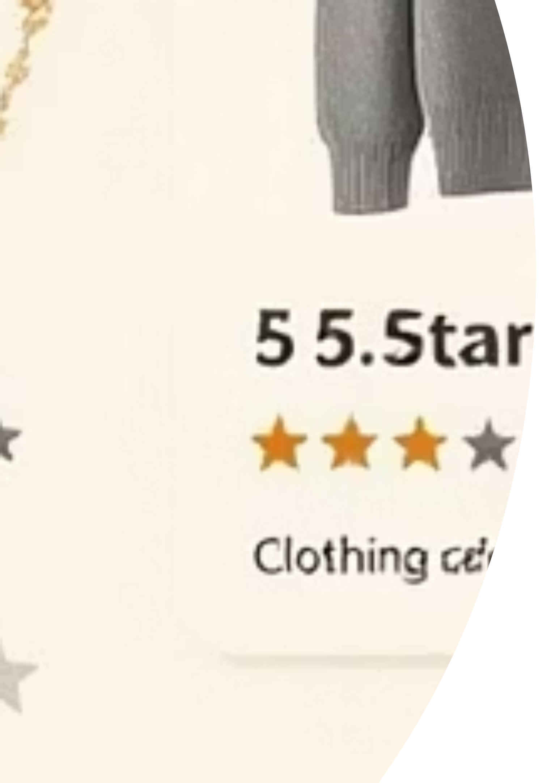


Top-Rated Products
Customer satisfaction data reveals clear winners in our product portfolio.
5
5
Blouse
Dress
Highest customer satisfaction with perfect 5-star ratings
Consistently excellent reviews across all customer segments
4
Shirt
Strong customer approval and repeat purchase rates

Slide 7


Shipping Preferences Impact
Express Shipping
$65
Average purchase amount
Standard Shipping
$58
Average purchase amount
Express shipping customers spend 12% more per transaction, indicating higher urgency and purchasing power.

Slide 8

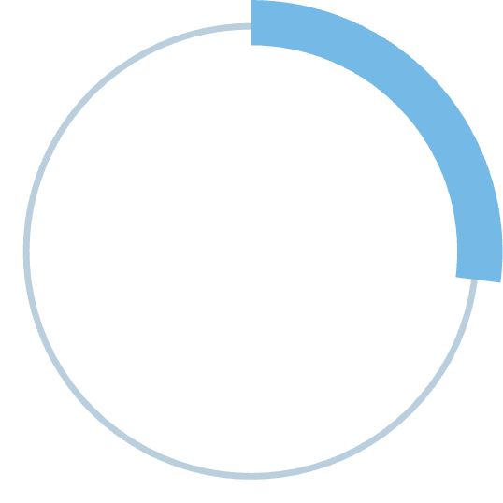


Subscription Impact
Subscribers demonstrate significantly stronger engagement and lifetime value metrics.
27%
42%
Higher Spend
Revenue Share
Subscribers vs non-subscribers per transaction
Total revenue contributed by subscription customers
3.2x
Loyalty Rate
Higher repeat purchase frequency compared to one-time buyers

Slide 9




Customer Segmentation
Understanding our customer base through purchase behavior reveals distinct segments requiring tailored strategies.
Loyal
1
15% - High value customers with 5+ purchases
Returning
2
35% - Regular shoppers with 2-4 purchases
New
3
50% - First-time buyers with growth potential
Primary objective: Convert New customers to Returning, and Returning to Loyal through targeted engagement strategies.

Slide 10


Strategic Recommendations
Boost Subscriptions
Promote exclusive benefits and perks to drive subscription adoption
Loyalty Programs
Reward repeat buyers with points and incentives to increase retention
Targeted Marketing
Focus campaigns on high-revenue segments and express shipping users
Product Positioning
Feature top-rated products prominently in marketing campaigns and homepage

